Slide 1


FOOD DELIVERY MANAGEMENT SYSTEM
TEAM Number 4
Team Members--
Roll No Name
417 Michael swaminathan
410 Uttkarsh khot
429 Nikhil dhupadal
421 Prasannakumar Roogi
406 Naveen

Slide 2
PROBLEM STATEMENT
The project aims to design and Implement the database for Food delivery system to maintain the following.
Each restaurant has the name and serves certain dishes of different cuisines, every restaurant has a special dish. Every restaurant is resided in different cities. The restaurant takes orders from the customer and the food is prepared and given to the delivery employee who will deliver the order. It keeps track of the orders that it handled.
The delivery employee will take the food from the restaurant and deliver to the given address. Each delivery employee has a salary and rating for his skills from the customers to whom he had delivered before. He handles the orders and where the food is to be delivered.
The customer will order from any restaurant which he likes provided he should order when the restaurant is open.
Every restaurant has some deals to offer on specific days. The customer can avail the offers.
The information of the types of dishes is to be maintained and which restaurant serves what dishes is also to be maintained. Even the information should include the dish price, its cuisine. Also certain dish is prepared at a certain time only.
The food delivered to the given address, who delivered the order and what was the feedback should be maintained.

Slide 3
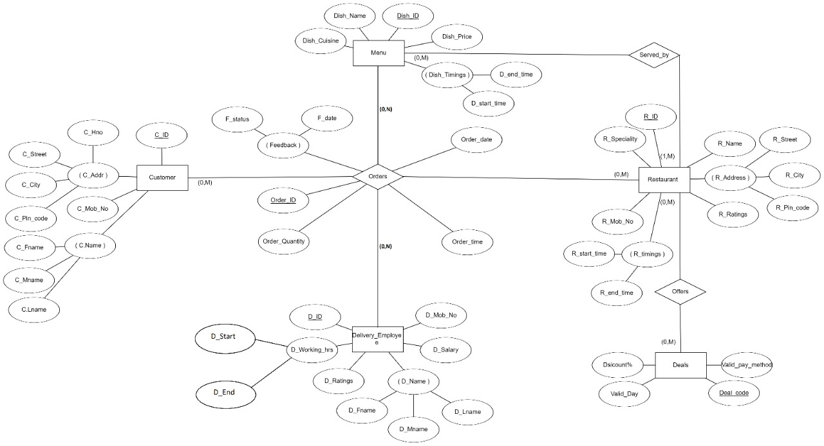
Entity-Relationship Model

Slide 4
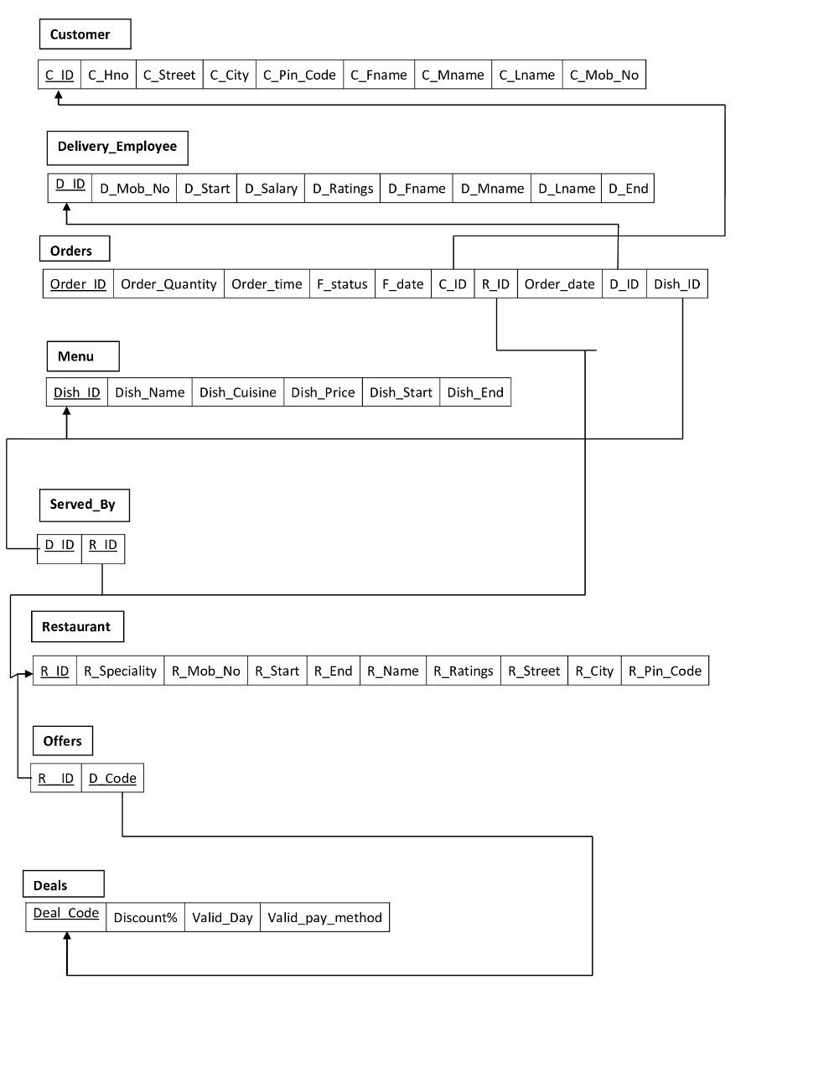
Relational-Schema

Slide 5
Create statements
create table customer (
c_id number constraint pk_cid primary key,
c_hno number constraint nn_c_hno not null,
c_street varchar2(20) constraint nn_street not null,
c_city varchar2(20) constraint nn_city not null,
c_pin_code number constraint nn_pin_code not null,
c_fname varchar2(20) constraint nn_fname not null,
c_mname varchar2(20) constraint nn_mname not null,
c_lname varchar2(20) constraint nn_lname not null,
c_mob_no varchar2(20) constraint uni_mob_no unique);
create table delivery_employee(
d_id number constraint pk_did primary key,
d_mob_no varchar2(20) constraint uni_dmob_no unique,
d_start number constraint nn_start not null,
d_end number constraint nn_end not null,
d_salary float constraint nn_salary not null,
d_ratings number constraint nn_ratings not null,
d_fname varchar2(20) constraint nn_dfname not null,
d_mname varchar2(20) constraint nn_dmname not null,
d_lname varchar2(20) constraint nn_dlname not null);
drop table customer1;
drop table customer;
drop table delivery_employee;
drop table menu;
drop table restaurant;
drop table offers;
create table menu(
dish_id number constraint pk_dishid primary key,
dish_name varchar2(20) constraint nn_dishname not null,
dish_cuisine varchar2(30) constraint nn_dishcuisine not null,
dish_price float constraint nn_dishprice not null,
dish_start number constraint nn_dishstart not null,
dish_end number constraint nn_dishend not null);
create table restaurant(
r_id number constraint pk_rid primary key,
r_specialty varchar2(20) constraint nn_rspecialty not null,
r_mob_no varchar2(20) constraint nn_rmob_no not null,
r_start number constraint nn_rstart not null,
r_end number constraint nn_rend not null,
r_name varchar2(20) constraint nn_rname not null,
r_ratings number constraint nn_rratings not null,
r_street varchar2(20) constraint nn_rstreet not null,
r_city varchar2(20) constraint nn_rcity not null,
r_pin_code number constraint nn_rpin_code not null);
create table orders(
order_id number constraint pk_orderid primary key,
order_quantity number constraint nn_orderquantity not null,
order_time number constraint nn_ordertime not null,
order_date date constraint nn_orderdate not null,
f_status varchar2(20) ,
f_date date constraint nn_orderfdate not null,
c_id number references customer(c_id),
r_id number references restaurant(r_id),
d_id number references delivery_employee(d_id),
dish_id number references menu(dish_id));
create table deals(
deal_code number constraint pk_validid primary key,
discount float constraint nn_validdiscount not null,
valid_day varchar2(20) constraint nn_valid_day not null,
valid_pay_method varchar2(20) );
create table served_by(
r_id number references restaurant(r_id),
d_id number references menu(dish_id));
create table offers(
r_id number references restaurant (r_id),
d_code number references deals (deal_code));

Slide 6
Insert statements
insert into restaurant values(1001,'idli',7495196382,8,10,'vaibhav',2,'laxmi','jamakandi',587312);
insert into restaurant values(1002,'jeera rice',1478529631,9,9,'panjurli',3,'shirur park','hubli',5800321);
insert into restaurant values(1003,'puri',7896415252,10,8,'kamat',4,'kmr road','belgaum',5800312);
insert into restaurant values(1004,'pav bhaji',9876543211,10,10,'vijay',3,'vidya nagar','banahatti',5800311);
insert into restaurant values(1005,'gobi',7896541239,9,6,'president',5,'hdmc road','melanti',587311);
insert into restaurant values(1006,'puri',9874587896,8,5,'naveen',4,'unkal road','hubli',5800311);
insert into restaurant values(1007,'idli',7495196789,11,10,'ice cube',3,'hosur road','hubli',5800311);
insert into restaurant values(1008,'jeera rice',749519324,8,11,'densions',4,'hosur road','hubli',5800311);
insert into restaurant values(1009,'fried rice',7495196542,9,8,'ocean pearl',5,'sultan road','dharawad',5800312);
insert into restaurant values(1010,'idli',7495196373,8,9,'revanth',3,'sultan road','dharawad',5800312);
insert into orders values(731,1,11,'1-jan-21','good','10-may-21',1120,1001,421,111);
insert into orders values(732,2,12,'2-feb-21','bad','11-aug-21',1121,1002,422,112);
insert into orders values(733,1,1,'3-may-21','avg','12-dec-21',1122,1003,423,113);
insert into orders values(734,1,2,'4-july-21','bad','13-oct-21',1123,1004,421,114);
insert into orders values(735,2,3,'5-mar-21','good','14-oct-21',1124,1005,422,116);
insert into orders values(736,3,4,'6-jun-21','avg','15-may-21',1125,1006,423,114);
insert into orders values(737,4,5,'7-sep-21','good','16-dec-21',1126,1007,425,112);
insert into orders values(738,5,6,'8-july-21','avg','17-sep-21',1127,1008,424,115);
insert into orders values(740,2,1,'10-mar-21','good','18-oct-21',1129,1010,426,118);
insert into deals values(661,50,'10-sep-20','cod');
insert into deals values(662,20,'11-oct-20','online');
insert into deals values(663,50,'12-sep-20','both');
insert into deals values(664,40,'12-dec-20','online');
insert into deals values(665,70,'13-dec-20','cod');
insert into deals values(666,80,'14-sep-20','cod');
insert into deals values(667,60,'15-oct-20','both');
insert into deals values(668,70,'16-dec-20','cod');
insert into deals values(669,50,'16-aug-20','online');
insert into deals values(670,60,'16-sep-20','cod');
insert into customer values(1120,21,'laxminagar','banahatti',587311,'daya','v','hatti',9189357645);
insert into customer values(1121,31,'vidyanagar','hubli',580031,'arun','k','naik',6753876875);
insert into customer values(1122,41,'unkal road','hubli',580031,'vanu','m','j',7890478939);
insert into customer values(1123,51,'keb road','tama khadi',587312,'relal','h','h',7893567865);
insert into customer values(1124,61,'temple road','mudhol',587335,'abhi','m','kudachi',6738978983);
insert into customer values(1125,71,'abmp road','bijapur',587385,'kiran','p','n',6748976578);
insert into customer values(1126,81,'keshav road','bagalkot',587392,'anjali','m','f',6784569890);
insert into customer values(1127,91,'ambedkar circle','rabakavi',587314,'bhargavi','r','mali',5467893456);
insert into customer values(128,101,'gandhi nagar','rampur',587315,'vinuta','k','katti',4678907890);
insert into customer values(1129,121,'laxmi nagar','banahatti',587311,'deepti','m','d',7654321234);
insert into customer values(1130,131,'vidya nagar','hubli',580031,'asha','k','gowda',5896321478);
insert into delivery_employee values(421,1234567892,10,9,10000,1,'manju','r','khot');
insert into delivery_employee values(422,2345678901,11,10,20000,2,'shasidar','m','s');
insert into delivery_employee values(423,3456789012,12,11,30000,3,'km','m','r');
insert into delivery_employee values(424,1234567893,13,12,40000,4,'prakash','b','hegde');
insert into delivery_employee values(425,0876543211,14,13,50000,5,'aruna','m','naik');
insert into delivery_employee values(426,7418529637,15,14,50000,6,'vimala','k','patil');
insert into delivery_employee values(427,7453951755,16,15,10000,7,'nameta','s','patil');
insert into delivery_employee values(428,7865585541,17,16,20000,8,'shaila','s','k');
insert into delivery_employee values(429,8526528555,18,17,40000,9,'pradeep','m','k');
insert into delivery_employee values(430,7851954528,19,18,90000,1,'vishal','s','k');
insert into menu values(111,'idli','south indian',40,1,2);
insert into menu values(112,'jeera rice ','north indian',110,2,3);
insert into menu values(113,'ni thali','north indian',340,3,4);
insert into menu values(114,'si thali','south indian',240,4,5);
insert into menu values(115,'fried rice','chinese',130,5,6);
insert into menu values(116,'puri','south indian',60,2,3);
insert into menu values(117,'idli','south indian',40,1,3);
insert into menu values(118,'egg biryani','north indian',70,8,9);
insert into menu values(119,'chicken thali','north indian',220,9,10);
insert into menu values(120,'puri','south indian',60,1,2);
insert into menu values(121,'idli','south indian',40,1,3);

Slide 7
insert into served_by values(1001,111); insert into served_by values(1002,112); insert into served_by values(1003,113); insert into served_by values(1004,114); insert into served_by values(1005,115); insert into served_by values(1001,116); insert into served_by values(1002,117); insert into served_by values(1003,118); insert into served_by values(1004,119); insert into served_by values(1002,120); insert into offers values(1001,661); insert into offers values(1002,662); insert into offers values(1003,663); insert into offers values(1004,664); insert into offers values(1005,661); insert into offers values(1006,665); insert into offers values(1007,666); insert into offers values(1008,664); insert into offers values(1002,663); insert into offers values(1001,662); insert into offers values(1006,665);

Slide 8
DESCRIPTION OF TABLES
a)customer b)delivery_employee
----------------------------------------------------------------------------------------------------------------------------------------------------------------------------------------
Attribute | Type | Constraints
C_ID | NUMBER | Primary key
C_HNO | NUMBER | NOT NULL
C_STREET | VARCHAR2(20) | NOT NULL
C_CITY | VARCHAR2(20) | NOT NULL
C_PIN_CODE | NUMBER | NOT NULL
C_FNAME | VARCHAR2(20) | NOT NULL
C_MNAME | VARCHAR2(20) | NOT NULL
C_LNAME | VARCHAR2(20) | NOT NULL
C_MOB_NO | VARCHAR2(20) | UNIQUE
Attribute | Type | Constraints
D_ID | NUMBER | Primary key
D_MOB_NO | VARCHAR2(20) | UNIQUE
D_START | NUMBER | NOT NULL
D_END | NUMBER | NOT NULL
D_SALARY | FLOAT | NOT NULL
D_RATINGS | NUMBER | NOT NULL
D_FNAME | VARCHAR2(20) | NOT NULL
D_MNAME | VARCHAR2(20) | NOT NULL
D_LNAME | VARCHAR2(20) | NOT NULL
Attribute | Type | Constraints
DISH_ID | NUMBER | Primary key
DISH_NAME | VARCHAR2(30) | NOT NULL
DISH_CUISINE | VARCHAR2(30) | NOT NULL
DISH_PRICE | FLOAT | NOT NULL
DISH_START | NUMBER | NOT NULL
DISH_END | NUMBER | NOT NULL
Attribute | Type | Constraints
R_ID | NUMBER | Primary key
R_SPECIALTY | VARCHAR2(30) | NOT NULL
R_MOB_NO | VARCHAR2(30) | UNIQUE
R_START | NUMBER | NOT NULL
R_END | NUMBER | NOT NULL
R_NAME | VARCHAR2(30) | NOT NULL
R_RATINGS | NUMBER | NOT NULL
R_STREET | VARCHAR2(30) | NOT NULL
R_CITY | VARCHAR2(30) | NOT NULL
R_PIN_CODE | NUMBER | NOT NULL
c)menu
d)restaurant

Slide 9
Attribute | Type | Constraints
ORDER_ID | NUMBER | Primary key
ORDER_QUANTITY | NUMBER | NOT NULL
ORDER_TIME | NUMBER | NOT NULL
ORDER_DATE | DATE | NOT NULL
F_STATUS | VARCHAR2(10) | F_STATUS = ‘Good’ or ‘average’ or ‘bad’
F_DATE | DATE | NOT NULL
C_ID | NUMBER | Foreign key references to Customer
R_ID | NUMBER | Foreign key references to Restaurant
D_ID | NUMBER | Foreign key references to Delivery_Employee
DISH_ID | NUMBER | Foreign key references to Menu
Attributes | Type | Constraints
DEAL_CODE | NUMBER | Primary Key
DISCOUNT | FLOAT | NOT NULL
VALID_DAY | VARCHAR2(10) | NOT NULL
VALID_PAY_METHOD | VARCHAR2(10) | ‘COD’ or ‘ONLINE’ only
f)deals
e)orders
Attribute | Type | Constraints
R_ID | NUMBER | Foreign key references to Restaurant
D_ID | NUMBER | Foreign key references to menu
Attribute | Type | Constraints
R__ID | NUMBER | Foreign key references to Restaurant
D_CODE | NUMBER | Foreign key references to Deals
h)served_by
g)Offers

Slide 10
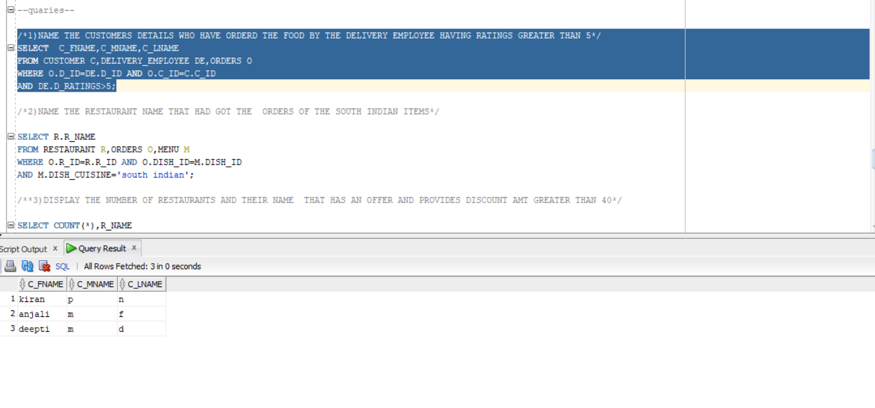
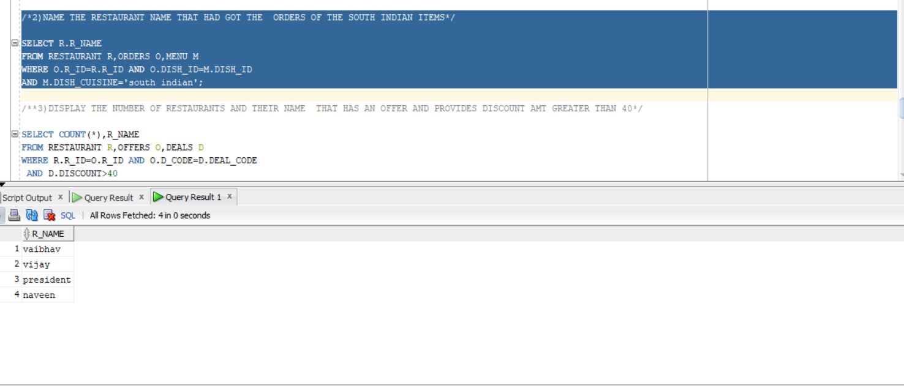
Quaries

Slide 11
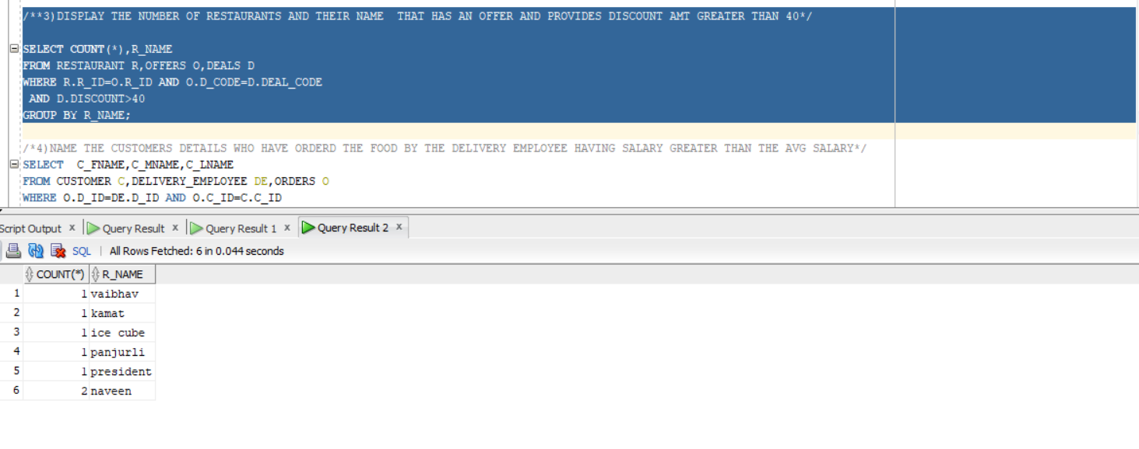
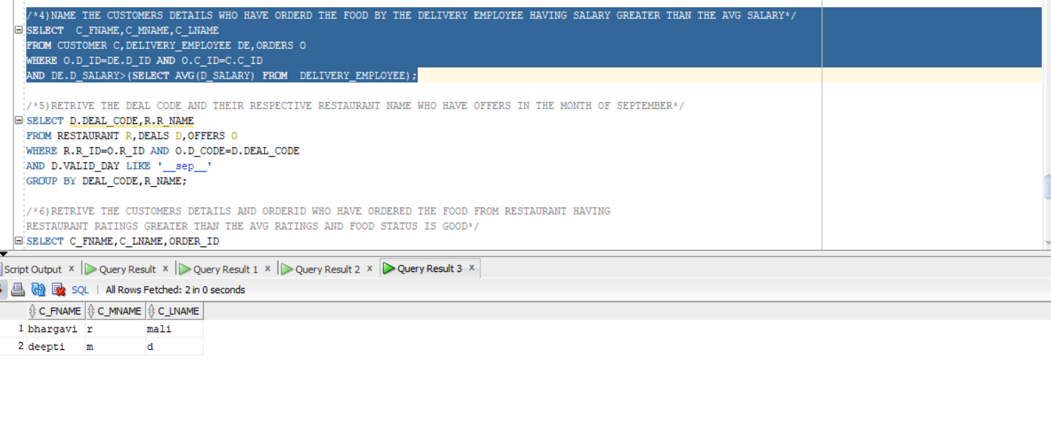

Slide 12
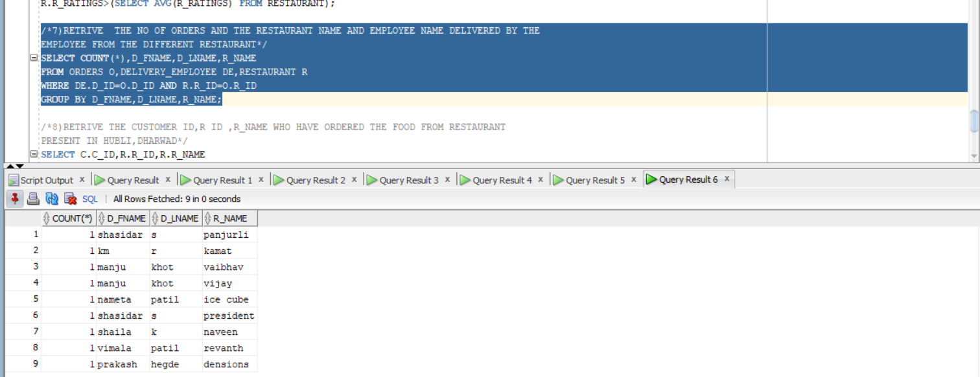
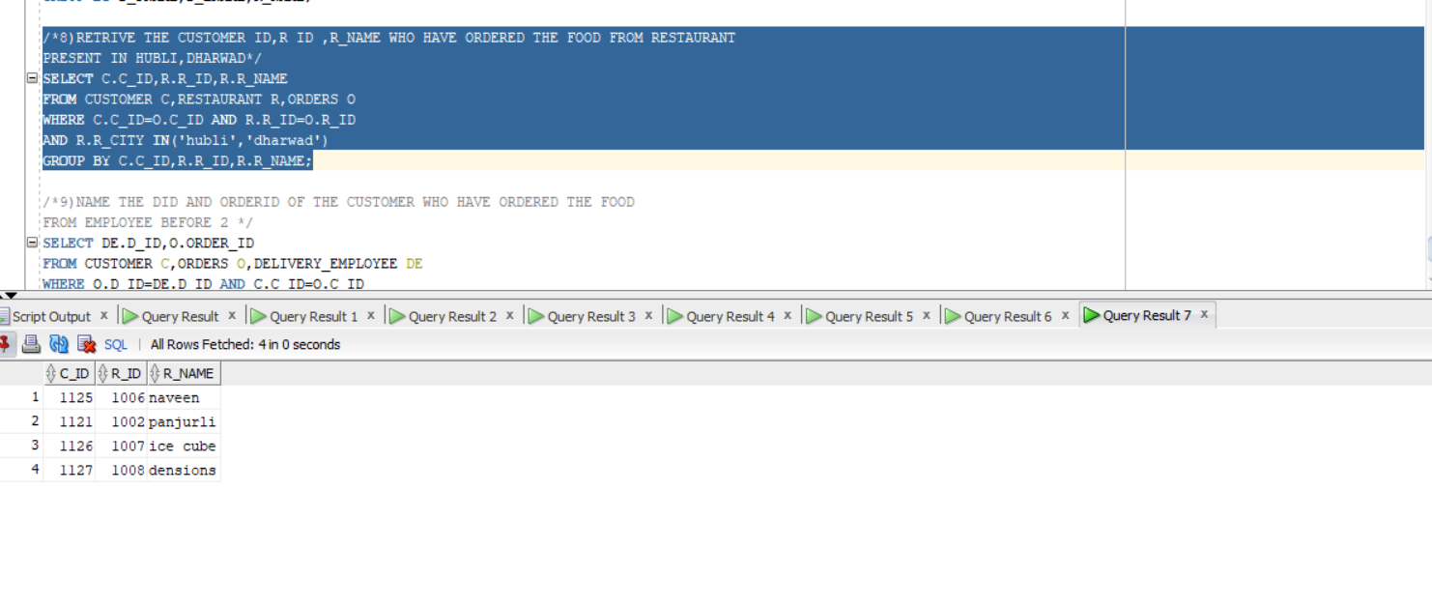

Slide 13
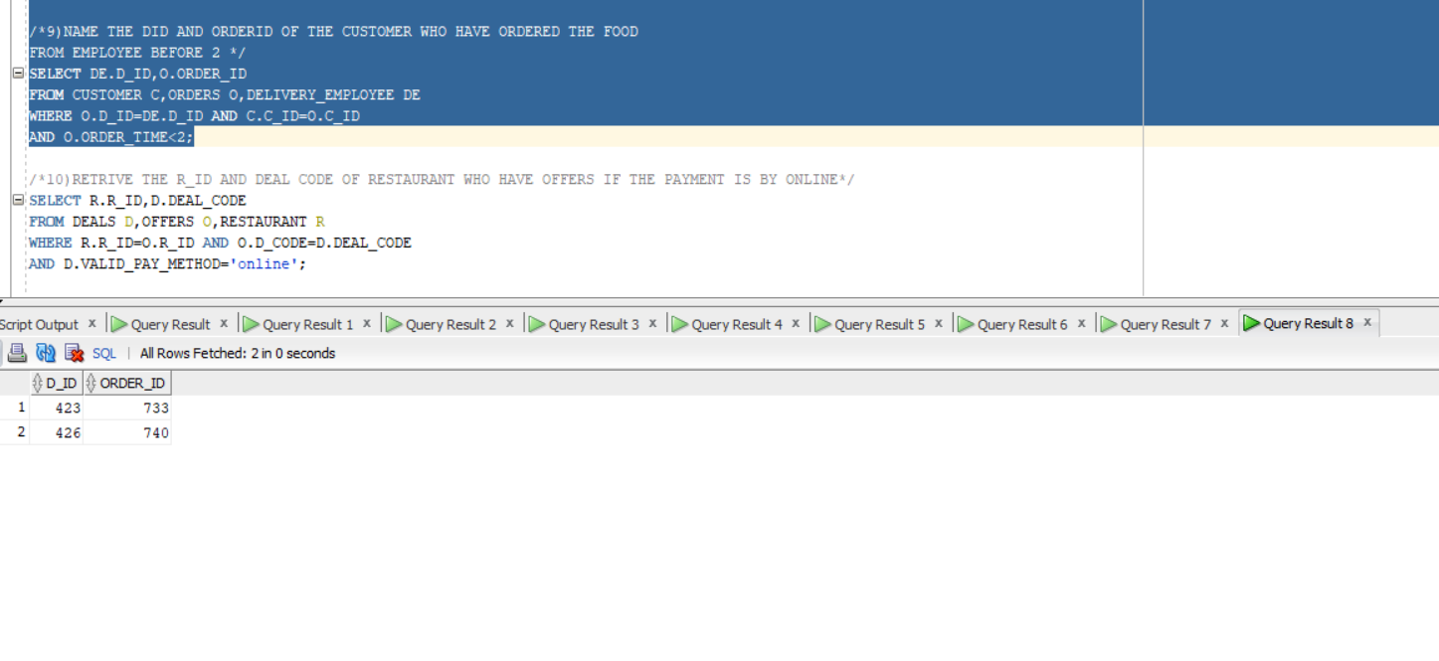
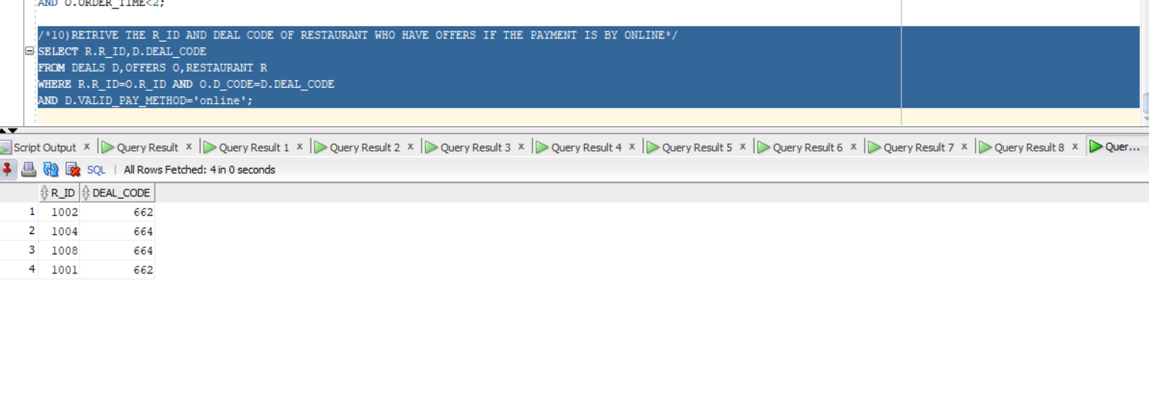

Slide 14
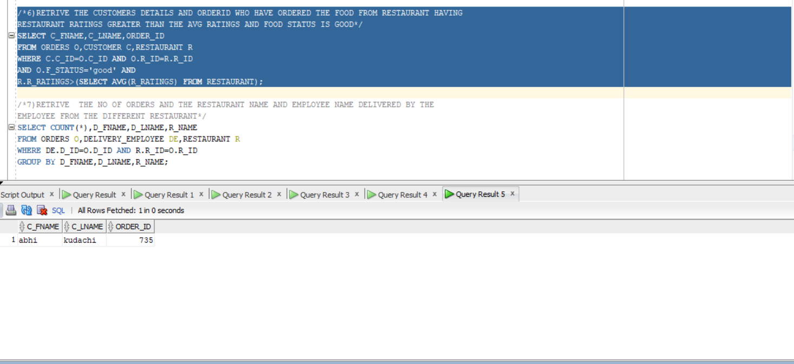
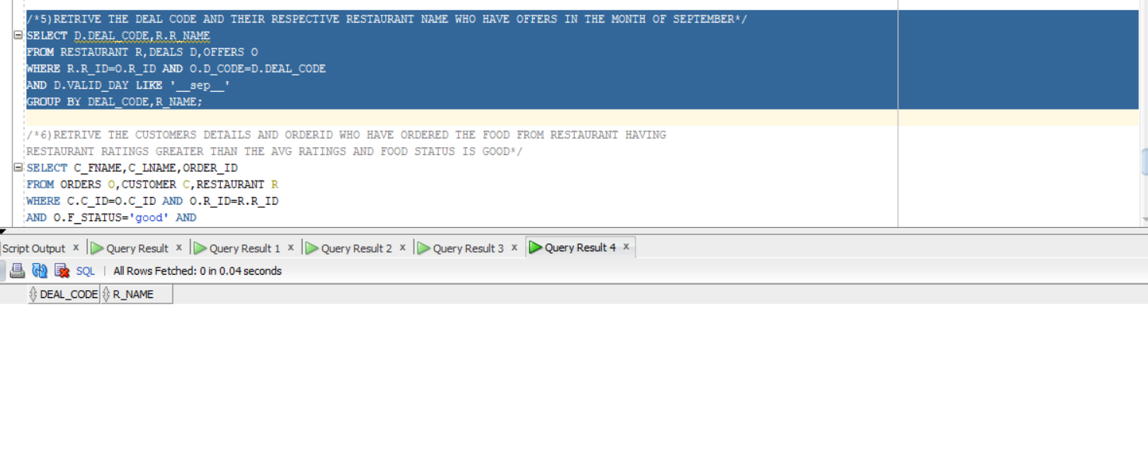

Slide 15
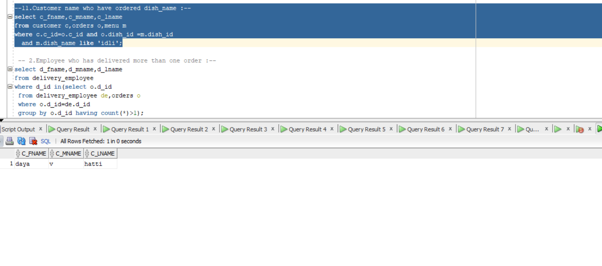
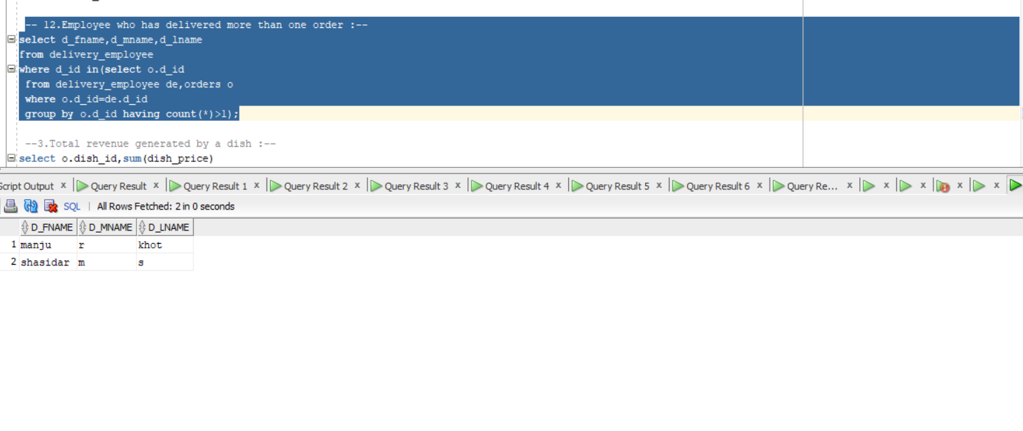

Slide 16
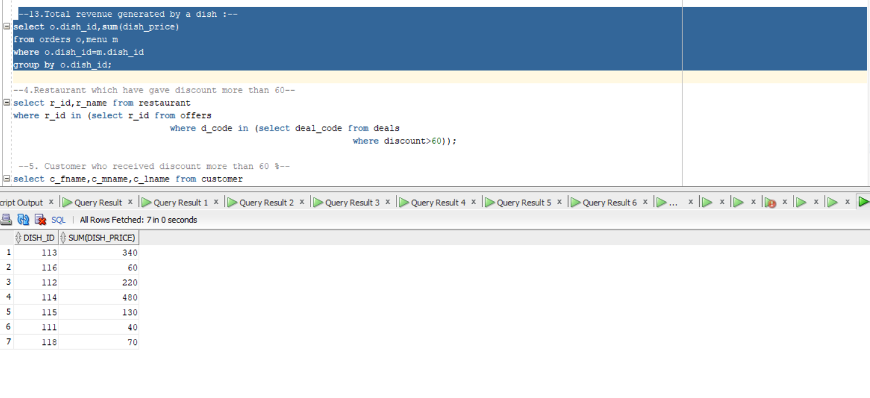
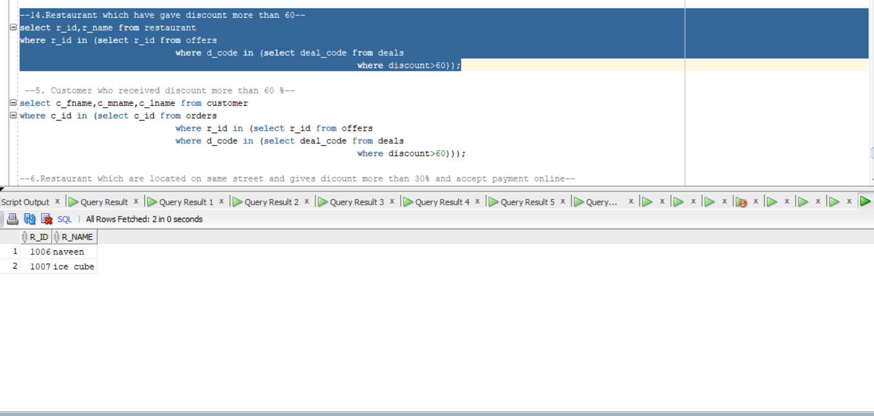

Slide 17
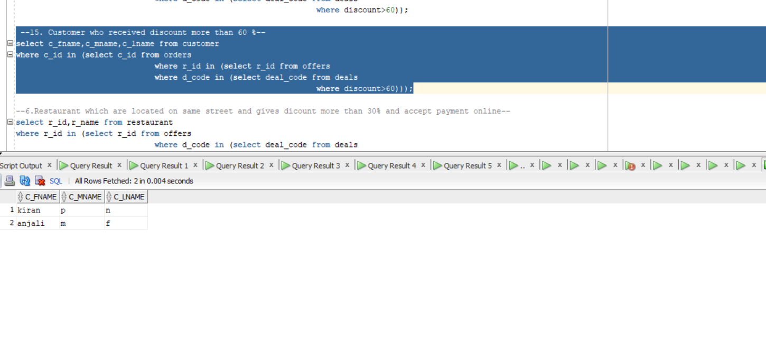
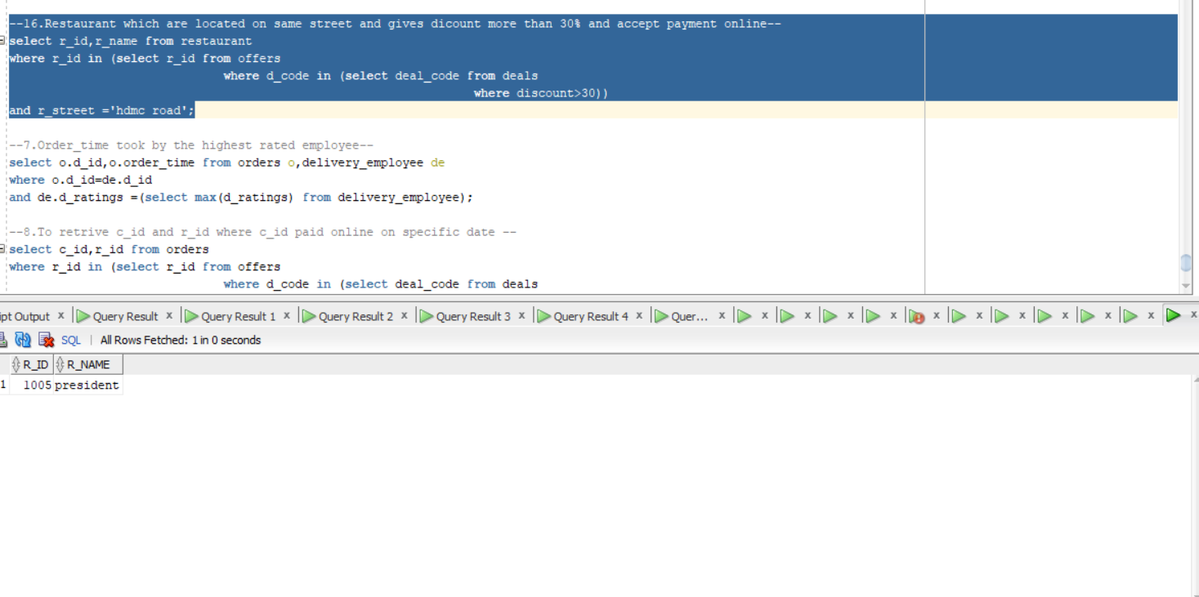

Slide 18
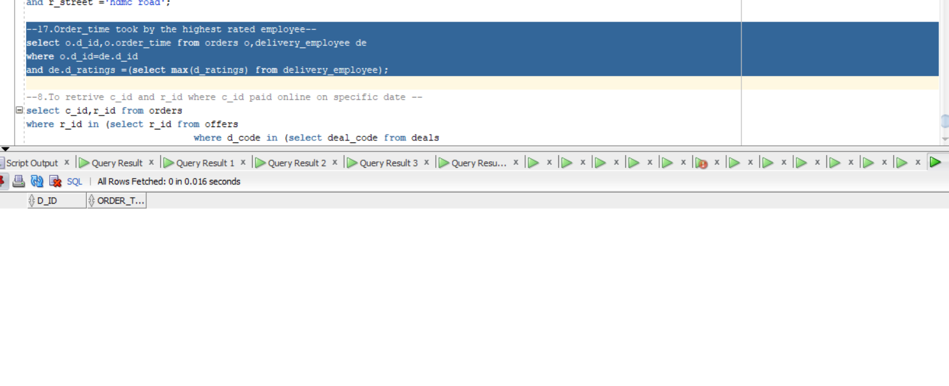
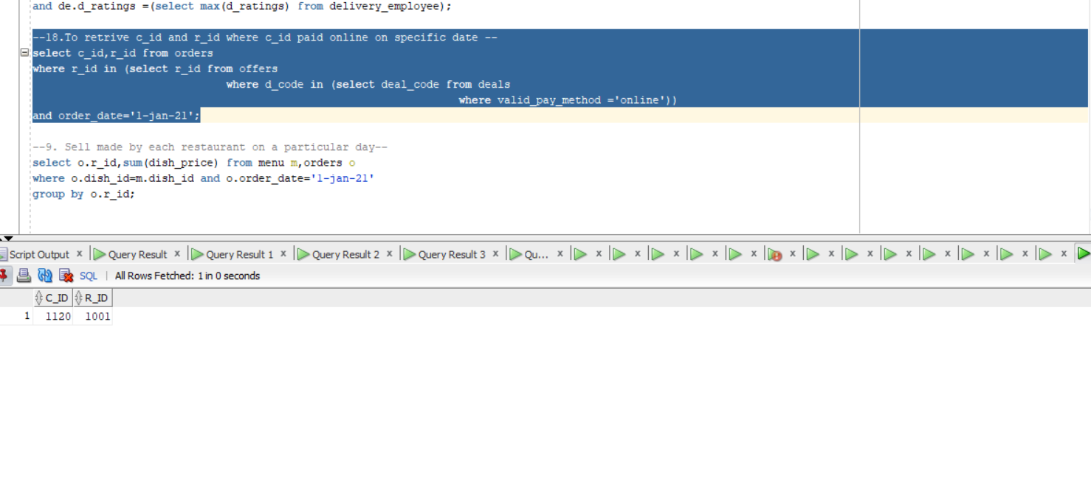

Slide 19
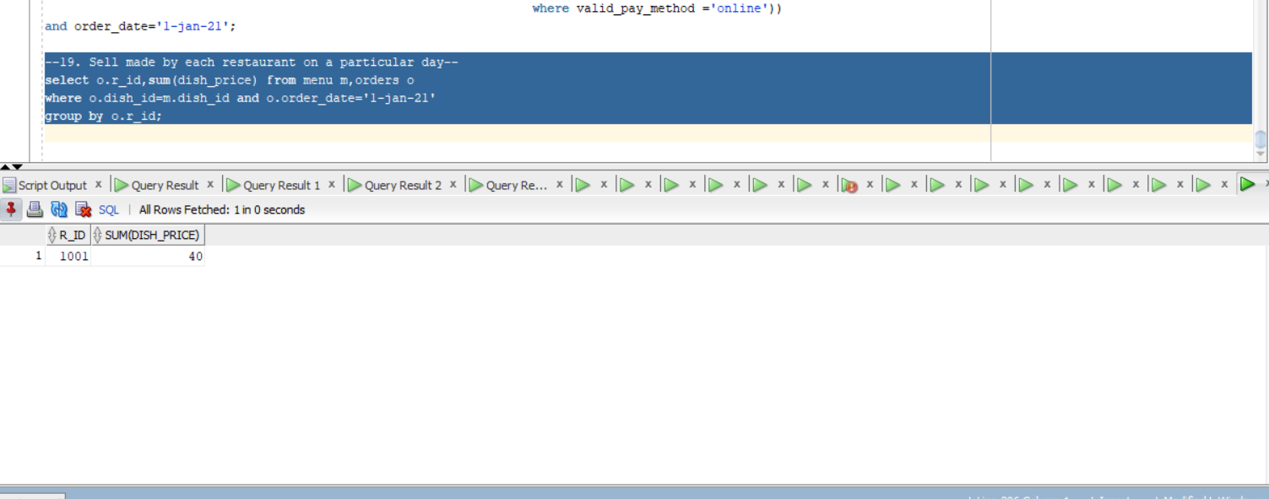
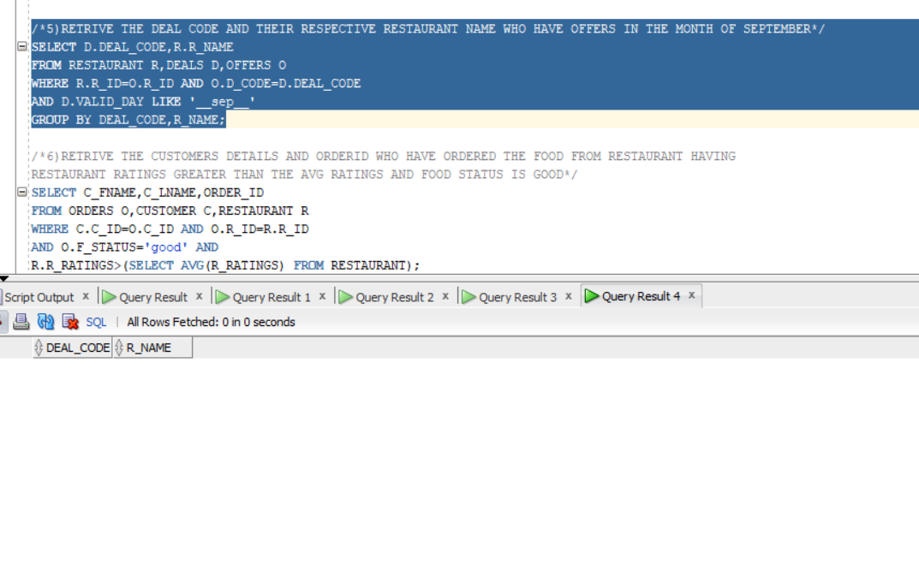

Slide 20
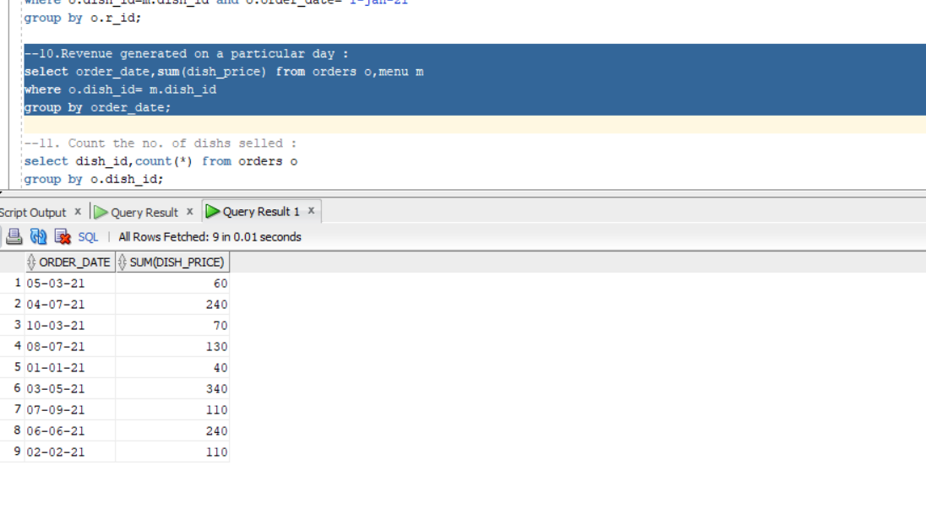
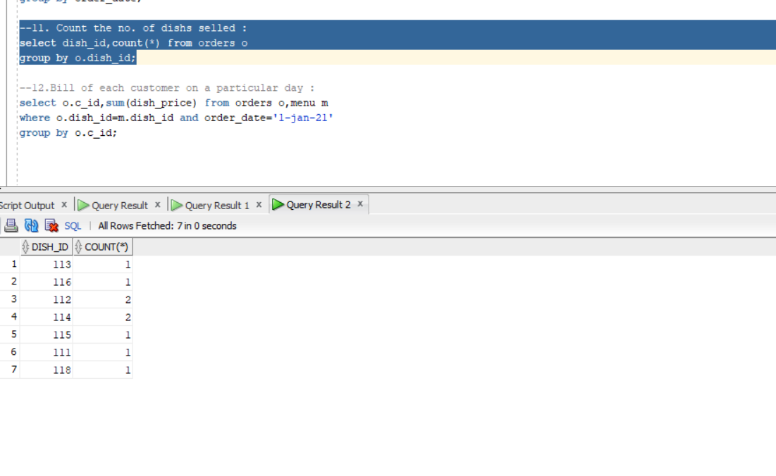

Slide 21
